Slide 1



AI-Driven Smart Healthcare Data Exchange and Analytics Ecosystem
Review – I Presentation
Presented By
Project Supervisor
Group Number: 15
Team Members:
Dr.Laiphangbam Melinda
Academic Details
Vadla Vishal
2510080031
Course / Subject: DSE &DBD
Department: Artificial Intelligence & Data Science
Institution: K L University, Hyderabad
Academic Year: 2026–27
Singam Tejaswini
2510080049
Sirisha
2510080017
Krishna Vamshi
2510080034

Slide 2

Problem Statement:
The healthcare industry grapples with significant data management issues that impede efficient care delivery and insights.
Fragmented Data
Patient & Operational Inefficiency
Suboptimal Appointment Scheduling
Healthcare organisations often operate with independent systems, leading to a severe lack of interoperability and data exchange.
Patients face repeated tests and cumbersome administrative tasks, while providers lose valuable time due to inaccessible medical histories.
Outdated systems result in long waiting times, scheduling conflicts, and inefficient utilisation of medical staff and facilities.
Critical Security Vulnerabilities
Missed Analytical Opportunities
Without robust authentication and access control, sensitive patient data is exposed to unauthorised access and potential breaches.
Vast amounts of collected healthcare data remain unanalysed, preventing the identification of crucial trends, risks, and operational improvements.

Slide 3
Problem Statement:
Modern healthcare is hampered by fragmented data, inefficient processes, and limited insights, directly impacting patient care and operational effectiveness.
Disconnected Data
Operational Inefficiencies
Security & Scalability Risks
Healthcare data is spread across separate systems, making patient record sharing difficult and leading to repeated tests and treatment delays.
This fragmentation results in poor utilization of valuable data, inefficient appointment management, and hampers overall hospital efficiency.
Existing platforms often struggle to provide robust data security and lack the scalability required for modern healthcare demands.
Who is most affected?
These issues negatively impact a range of stakeholders:
Patients: Experience delayed treatment and redundant medical tests.
Doctors: Face challenges with incomplete patient medical histories.
Hospitals & Laboratories: Struggle with inefficient data management and poor coordination.
Healthcare Administrators: Lack critical insights for effective planning and resource allocation.

Slide 4


Need for the Project: Societal Imperative
Our AI-driven healthcare ecosystem is designed to address critical needs, enhancing care for patients and efficiency for providers.
Why is this Project Needed?
To create a secure, centralized healthcare platform for unified data.
To enable seamless data exchange using modern APIs.
To improve appointment management and electronic medical records.
To leverage AI for better clinical and operational decisions.
1
2
Patients
Doctors
Benefit from faster treatment, reduced wait times, and easy access to their complete medical records.
Gain access to comprehensive patient histories, enabling more accurate diagnoses and personalised care plans.
3
4
Hospitals & Administrators
Societal Impact
Achieve improved operational efficiency, better resource management, and data-driven insights for strategic planning.
Contributes to digital transformation in healthcare, reducing costs, improving public health outcomes, and fostering innovation.
This project aims to bridge current gaps in healthcare data management, leading to tangible improvements in patient care and operational effectiveness.

Slide 5

Project Objectives
Efficient Data Management
Secure Appointments & EMR
Interoperable APIs
Authentication & Authorization
RESTful interfaces to enable secure exchange across systems and third-party integrations.
Capture and maintain patient and clinician records with audit trails.
JWT authentication and role-based authorization (patients, doctors, labs, admins).
Electronic Medical Records and appointment workflows with conflict resolution and notifications.
Hybrid Data Storage
AI Analytics
Relational DB for structured records; MongoDB for documents, notes, and reports.
Dashboards, trend detection, workload monitoring and decision support using ML pipelines.

Slide 6

Our Solution: AI-Driven Healthcare Ecosystem
To overcome the challenges in existing healthcare systems, we propose an AI-Driven Smart Healthcare Data Exchange and Analytics Ecosystem. Our secure, scalable platform connects patients, doctors, hospitals, laboratories, and administrators through a unified ecosystem, going beyond traditional hospital management systems.
Centralised Data Management
Efficient Patient Workflow
Securely access and update patient records, eliminating fragmented data, reducing duplicate tests, and providing complete patient histories for better treatment.
Includes patient/doctor management, online appointment scheduling, and a digital EMR system to enhance efficiency, reduce paperwork, and minimise waiting times.
Interoperable APIs
Robust Security & Access
Uses REST APIs for secure and seamless data exchange between different modules, enabling easy integration with future healthcare applications and systems.
JWT-based authentication and role-based access control protect sensitive medical information, ensuring users only access relevant data according to their roles.
Hybrid Data Storage
AI-Powered Analytics
A hybrid database architecture (MySQL for structured, MongoDB for unstructured) offers scalability and flexibility for various data types like reports and notes.
An AI module analyses healthcare data to generate reports, identify disease trends, monitor workloads, and support data-driven clinical and operational decisions.
Overall, our solution provides a secure, intelligent, and scalable healthcare platform that improves patient care, hospital efficiency, and healthcare management.

Slide 7
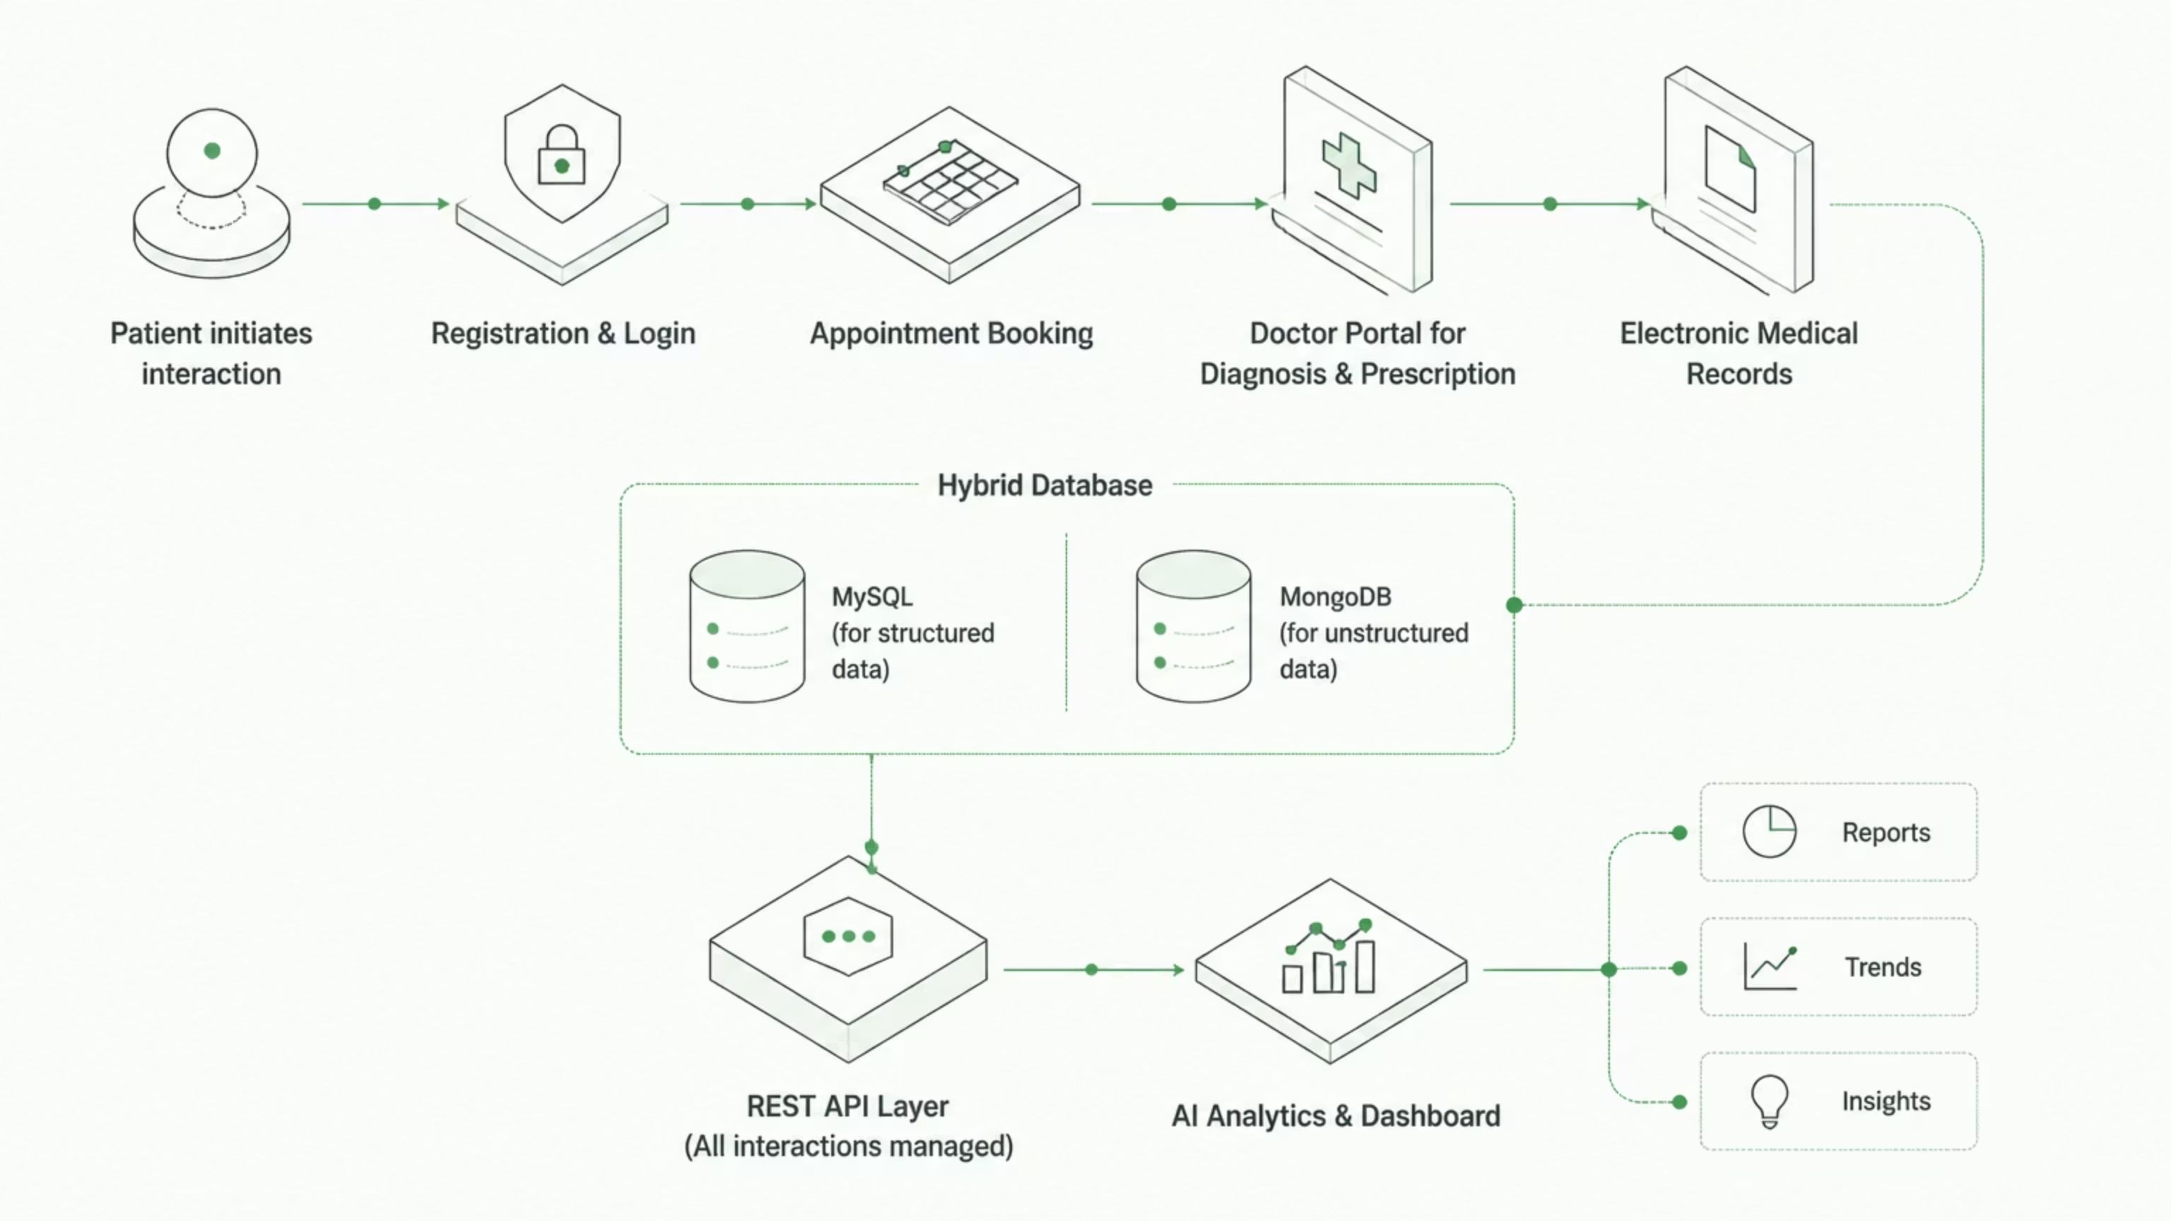


Slide 8
Project Objectives: Main Modules
Our AI-driven healthcare ecosystem is structured around six core modules, each designed to address specific functionalities and streamline operations within the healthcare domain.
Patient & Doctor Management
1
Patient registration and profile management
Doctor profile and schedule management
Appointment & Medical Records
2
Online appointment booking
Electronic Medical Records (EMR)
Prescriptions and laboratory reports
Healthcare Analytics
3
Disease trend analysis
Doctor workload monitoring
Patient demographic analysis
Administrative dashboards
REST API & Authentication
4
Secure REST API communication
JWT Authentication
Role-Based Access Control (RBAC)
Database Management
5
MySQL for structured healthcare data
MongoDB for document-based healthcare records
Deployment & Testing
6
API testing using Postman
Backend deployment using Docker/Cloud
System documentation and validation

Slide 9

Feasibility & Technology Stack
Our proposed AI-Driven Smart Healthcare Data Exchange and Analytics Ecosystem is designed to overcome existing challenges, offering a secure, scalable, and interconnected platform that unifies patients, doctors, hospitals, laboratories, and administrators. This comprehensive solution leverages modern architectural patterns and robust technologies to deliver significant improvements in healthcare management and patient care.
Integrated Ecosystem
Centralised Data Management
Operational Efficiency
Secure Communication
A secure and scalable platform connecting all healthcare stakeholders for unified data exchange.
Eliminates fragmentation, reduces duplicate tests, and provides complete patient histories for clinicians.
Streamlines patient/doctor management, online appointments, and digital EMR, reducing paperwork and wait times.
REST APIs for data exchange, with JWT authentication and role-based access control for sensitive information.
Hybrid Database Architecture
AI-Powered Analytics
MySQL for structured records and MongoDB for unstructured data, ensuring scalability and flexibility.
Generates reports, identifies disease trends, monitors workloads, and supports data-driven decision-making.

Slide 10

Feasibility & Technology Stack
Our ecosystem leverages proven, modern technologies to ensure robust performance, scalability, and security. The development process is streamlined by well-established tools and frameworks, fostering efficient collaboration and future-proofing the platform.
Development Environment
Frontend
Backend
Standard laptops with 8GB RAM and internet connectivity are sufficient for development.
User interfaces will be built using React.js for a dynamic and responsive user experience.
The robust backend services will be developed with Spring Boot, ensuring stability and scalability.
Data Storage
Security & APIs
Version Control & Deployment
MySQL for relational data and MongoDB for flexible NoSQL document storage.
JWT-based authentication for secure user access; Postman and Swagger for API testing.
Git and GitHub for collaborative development, with Docker considered for containerized deployment.
Data Strategy
Initially, sample patient records for testing, with future plans for AI model analysis on collected data.

Slide 11


What Makes Our Project Unique?
Our AI-Driven Healthcare Ecosystem is a comprehensive platform designed to revolutionise healthcare data exchange and analytics, moving beyond the limitations of traditional hospital management systems.
Existing Systems
Our Proposed System
Stores patient records only
Secure healthcare data exchange using REST APIs
Single SQL database
Hybrid MySQL + MongoDB architecture
Limited data sharing
JWT authentication with role-based access
Basic reports
AI-powered analytics dashboard
Manual decision making
Disease trend analysis and hospital insights
Hospital-centric
Scalable ecosystem connecting multiple healthcare stakeholders
Key Innovative Features
Hybrid Database Architecture
Secure REST API Integration
Combines MySQL for structured data and MongoDB for flexible NoSQL document storage.
Enables seamless and secure data exchange across diverse healthcare systems.
AI-Powered Healthcare Analytics
Role-Based Secure Access
Provides intelligent insights for trend detection, workload monitoring, and decision support.
Ensures data privacy and compliance with granular access controls for different user roles.
Centralised Electronic Medical Records
Scalable Backend Architecture
Offers a unified and complete view of patient histories, reducing fragmentation and errors.
Designed to handle increasing data volumes and user loads without compromising performance.

